Slide 1




The iot LoRa project
Presentation
TEAM MEMBERS :
PAUL LELOUP & ZAKARIA EL RHOSN
PROJECT SUPERVISOR : THIERRY GIL
Notes:
Present my synthesis and state of the art about my end of study industrial project named Study & conception of a smart sensor on fpga. I’m managed by Pascal Benoit, an university lecturer and researcher and i work for help the thesis of Guillaume Patrigeon. The end of study industrial project takes places at LIRMM (Informatic, Robotic and Microelectronic Laboratory)

Slide 2
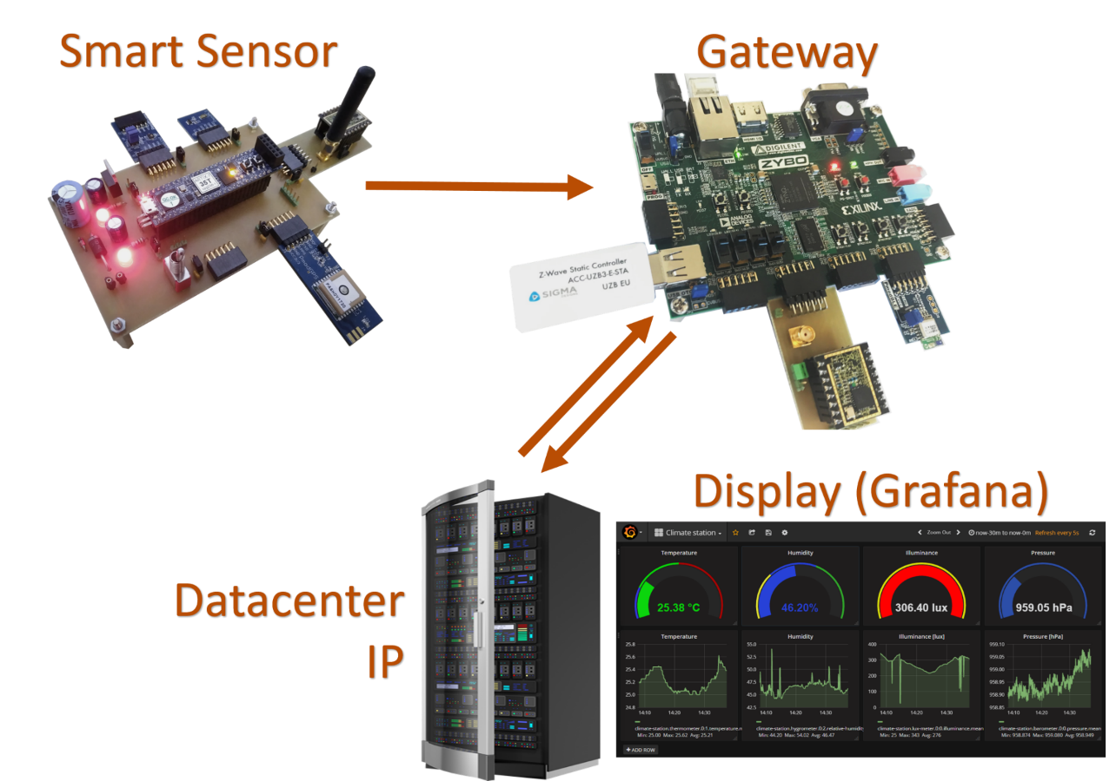
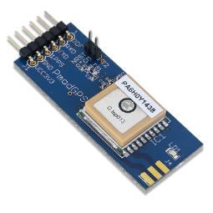
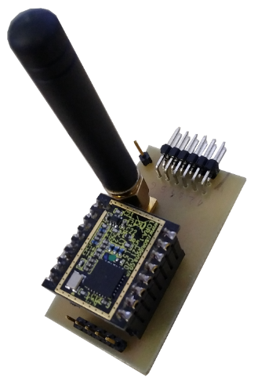
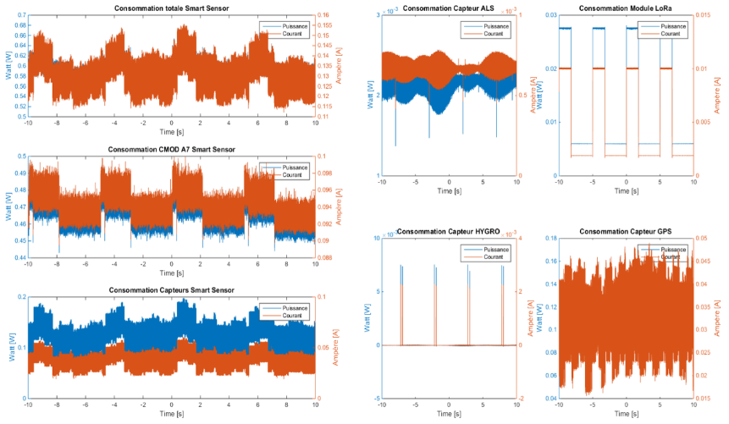
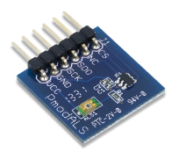
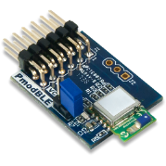
PRODUCT MARKETING SHEET: SmART SENSOR
The Smart Sensor send sensors data to his gateway by radio
Sensors :
Temperature
Humidity
Brightness
Localisation, Hour, Date
Radio modules:
LoRa (long range≈ 1 Km)
Bluetooth Low Energy BLE (≈10 m)
Easy to measure consumption of all sensors :
Notes:
First I will introduce the context and the problematic
After that, i will present you the sensors states of the art with the differents interfaces of communication
Next to that, i will speak about the communication states of the art
Before the conclusion and the result, I will present fastly the organisation of the project.

Slide 3
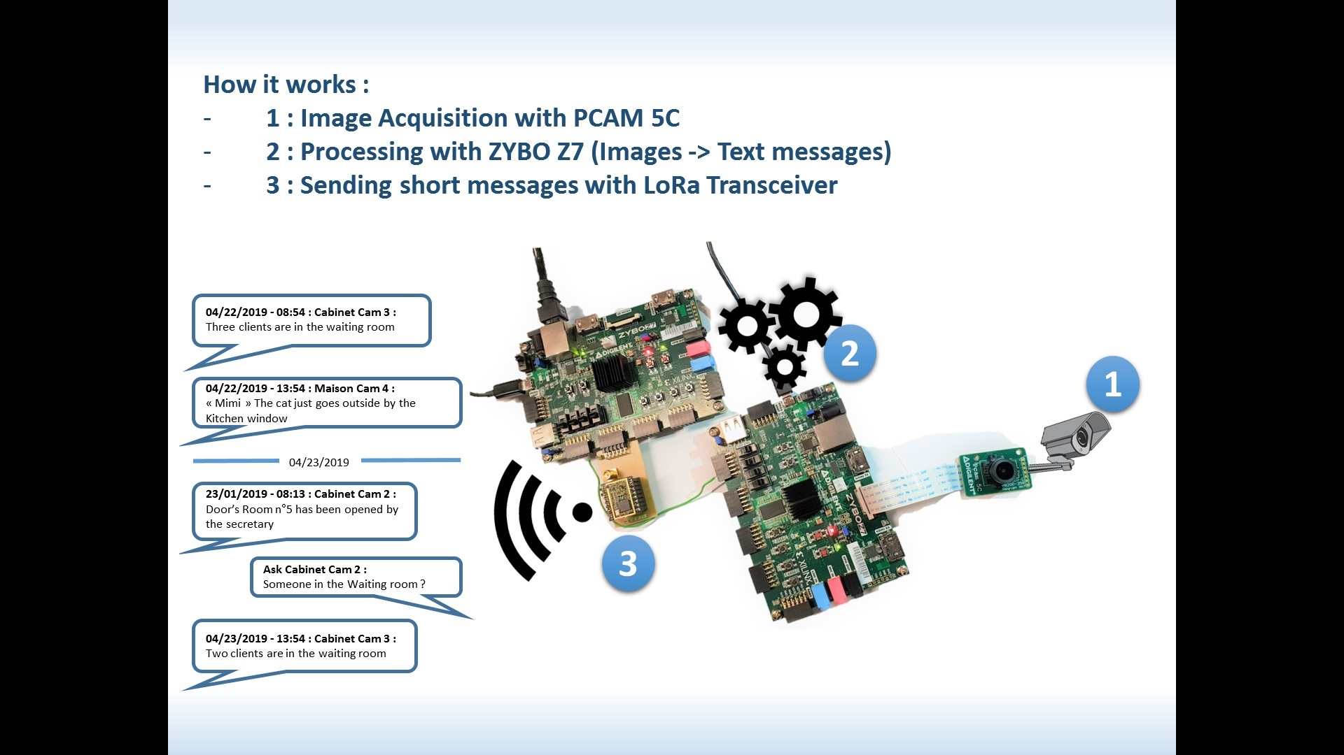


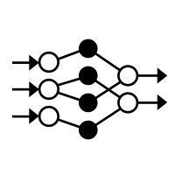

PRODUCT MARKETING SHEET: SMART GATEWAY
The Smart Gateway receive data from Smart devices, Process Images, and share all theses informations through large network
Monitors and Informs users of events that happened, in complete confidentiality.
Practice in several areas
Ability to communicate with other Smart Cameras for an even higher level of monitoring and security.
The SoC on the development board facilitates the integration of Artificial Intelligence into the system
Low memory requirement due to internal image processing.
Notes:
First I will introduce the context and the problematic
After that, i will present you the sensors states of the art with the differents interfaces of communication
Next to that, i will speak about the communication states of the art
Before the conclusion and the result, I will present fastly the organisation of the project.

Slide 4
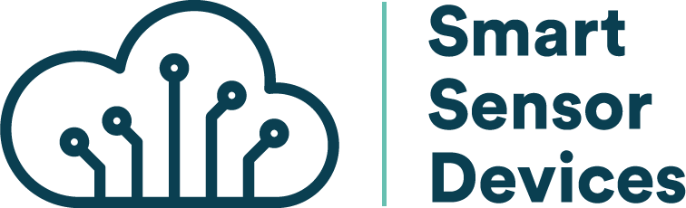
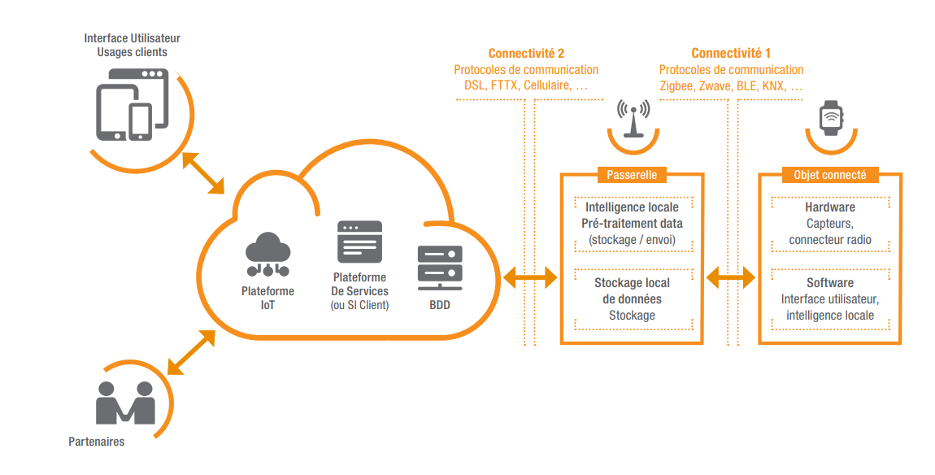



SUMMARY
Introduction
Smart Sensor
Fonctionnalities
Design : Hardware
Design : Software
Result : Consumption test
Smart Gateway
Overview
Applications
Component and Global Architecture
Hardware Design of Smart Camera
IP Design for LoRa Transceiver
Conclusion
Notes:
First I will introduce the context and the problematic
After that, i will present you the sensors states of the art with the differents interfaces of communication
Next to that, i will speak about the communication states of the art
Before the conclusion and the result, I will present fastly the organisation of the project.
Overview
Applications
Component and Design
Hardware Desgin Smart Camera
IP Design for LoRa Transceiver

Slide 5
CONTEXT
Surveillance
Industrial Project of the End of Studies
Radio communication
Confidentiality
The French National Centre for Scientific Research (CNRS)
Internet of Things(IOT)
Smart
Sensors
23,14 billion connected devices
Embedded Systemes
Laboratory of Computer Science, Robotics and Microelectronics of Montpellier(LIRMM)
Image Processing
IA
Security
Field-Programmable Gate Array (FPGA)
Communication Protocol for IoT
Long Rand Low Power Networks
Surveillance
Notes:
LIRMM
Research unity depend of UM and CNRS ( National Center for Scientific Research)
IOTdevices exchanges data
FPGA
Field-Programmable Gate Array
Reconfigurable circuit, change the logic
Standard component, fast time conception and low cost for small series (ex less than 10 000 unity)

Slide 6
Introduction
Research about IoT
Prototypes : The Smart Sensor and The Smart Gateway
Objectives of the project: Create a Smart Gateway and Smart Sensor to establish connection between Device of Future to send/receive datas. Smart Sensor and Smart Camera.
Tools Required
Differents steps…

Slide 7
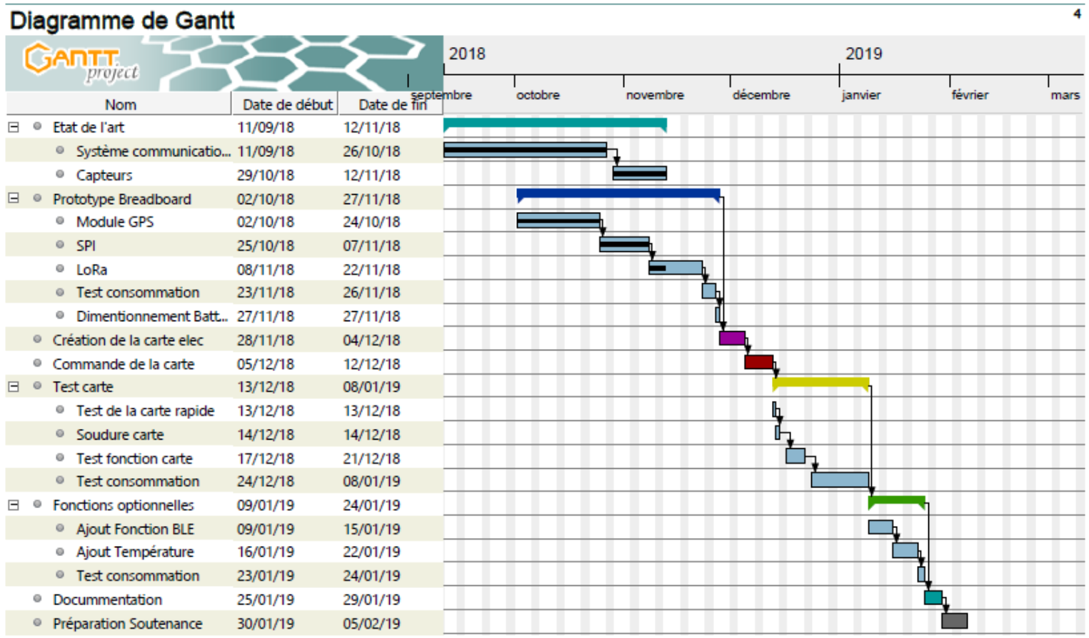
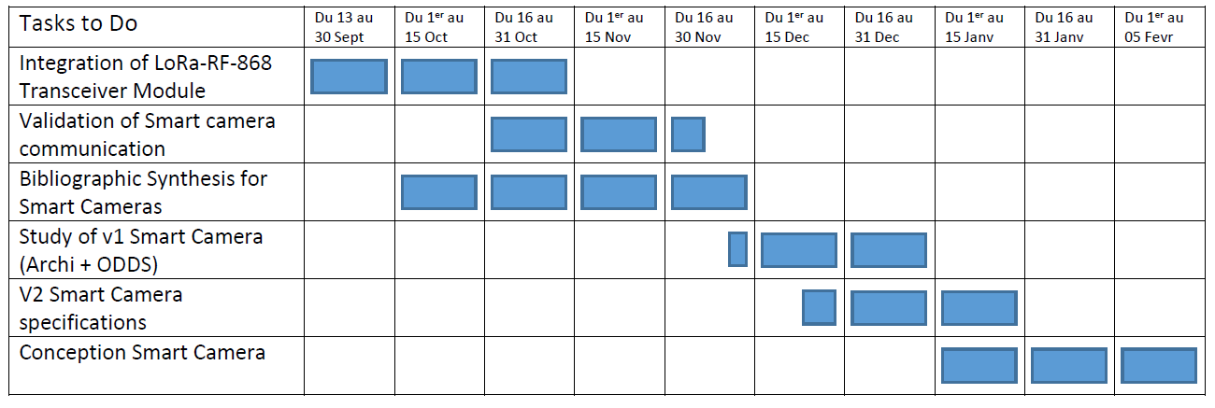
SMART SENSOR : GANTT
Gantt Diagram for Smart Sensor Project
Gantt Diagram for Smart Gateway and Camera

Slide 8

system

Slide 9

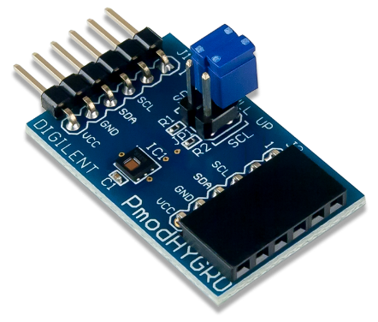
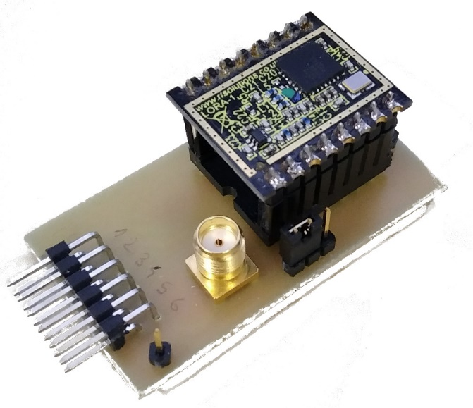
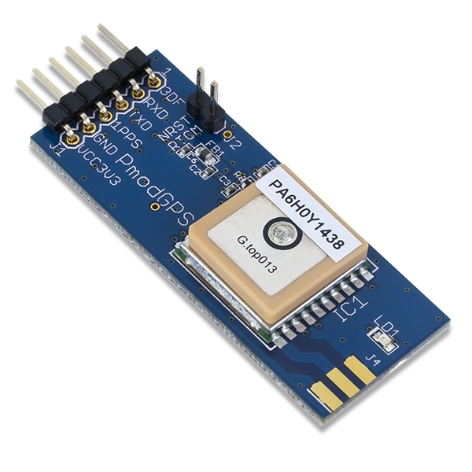
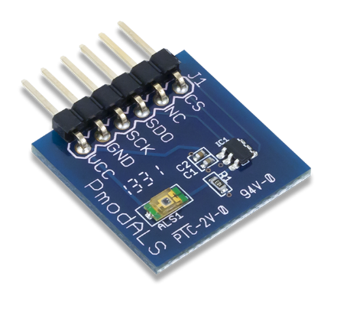
SMART SENSOR : SENSORS AND RADIOS MODULES
Temperature &
Humidity
BLE
LoRa
GPS
Brightness

Slide 10
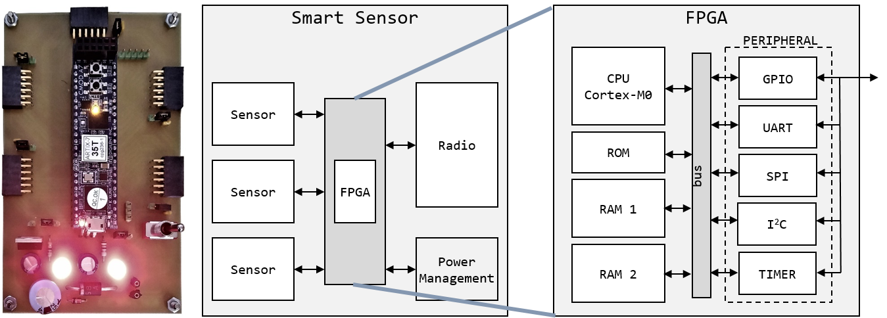
SMART SENSOR : HARDWARE DESIGN

Slide 11
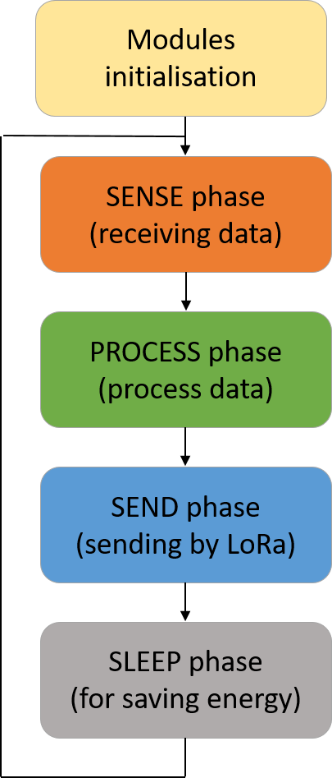
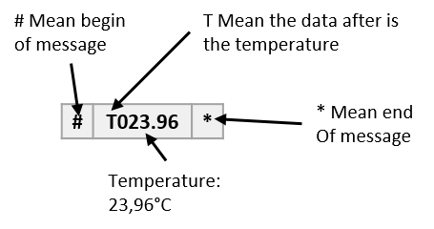
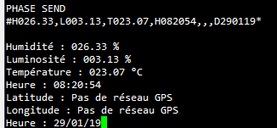
SMART SENSOR : SOFTWARE DESIGN

Slide 12
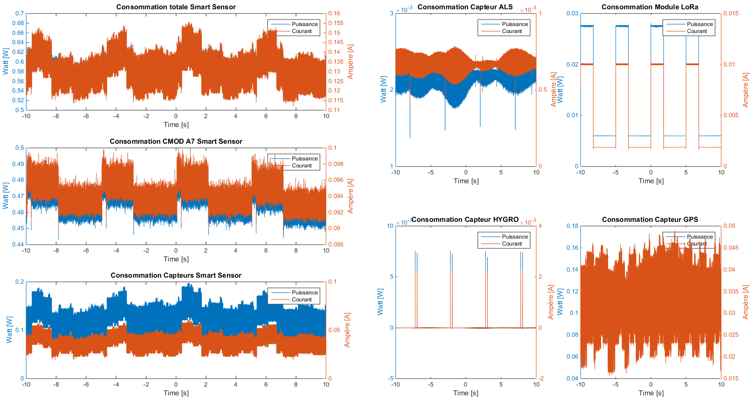
SMART SENSOR : CONSUMPTION MEASURE

Slide 13
SMART SENSOR : CONSUMPTION MEASURE

Slide 14



SmART GATEWAY – Smart sensor & camera
Overview

Slide 15
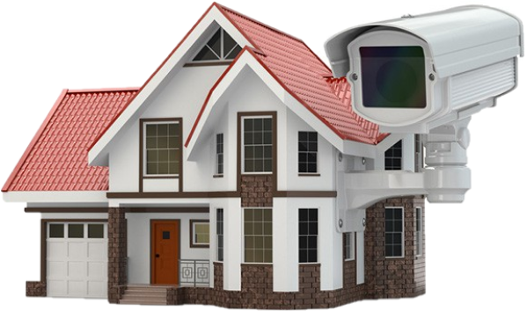
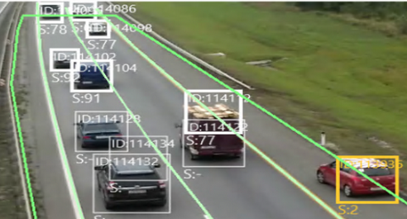

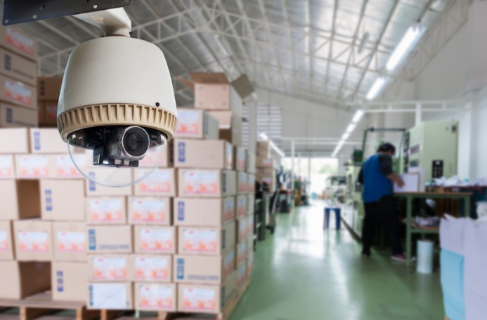
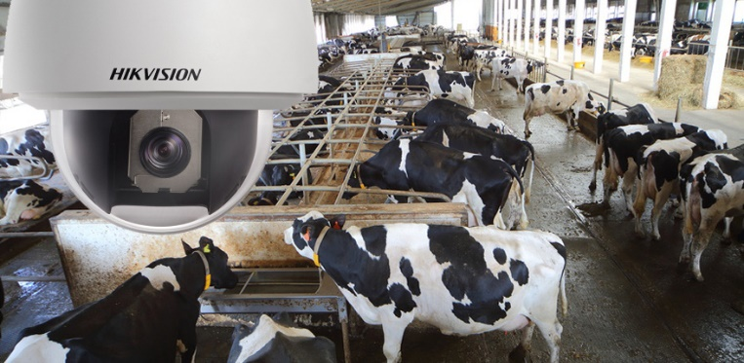
SmART GATEWAY with camera
Applications
Smart Home
Surveillance intelligente
intérieur/extérieur [2]
Monitoring de la circulation routière
Smart Road [3]
Smart Camera
Surveillance milieu Agricole (Agriculteurs et Eleveurs)
Surveillance et Sécurité Milieu Industriel

Slide 16
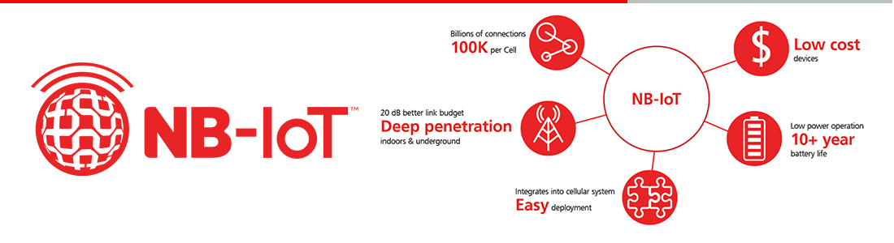
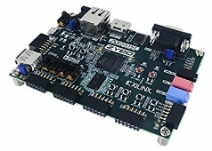
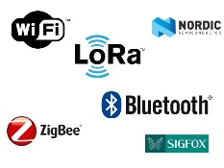
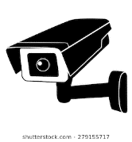
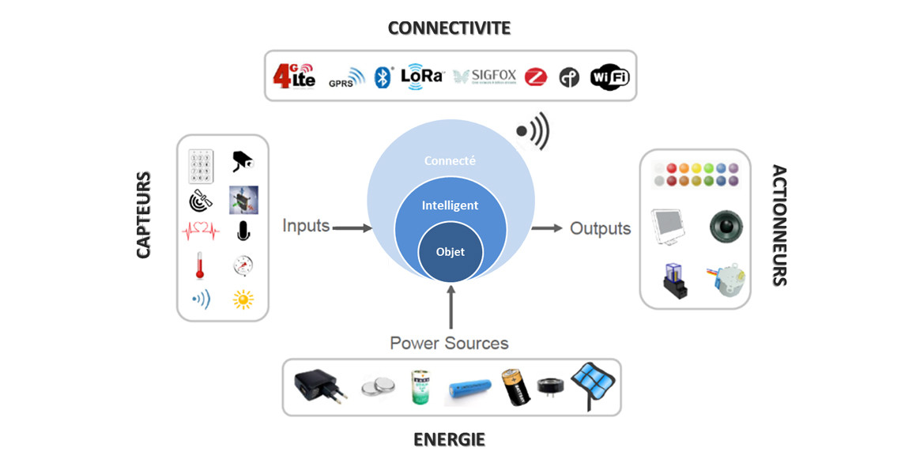
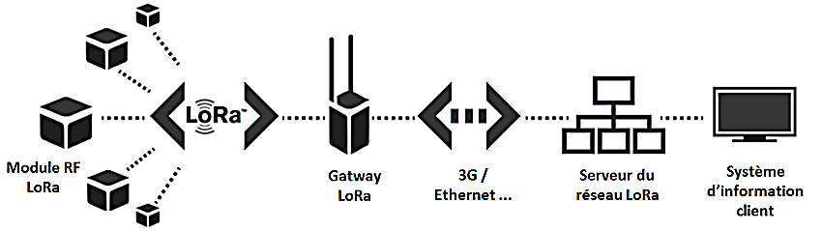
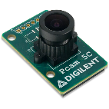
SmART GATEWAY with camera
Component and Design
Development platform
Microprocesseur
FPGA
Mémoire
GPIOS
Communication peripherals
Carte ZYBO Xilinx
Connectivity and
Data Trassmission
Data Analyse and Processing
Data Acquisition (PCAM, GPS, Temperature…)
SMART CAMERA
Image Acquisition
Data Processing with several algorithms
Transmission of pertinent informations

Slide 17

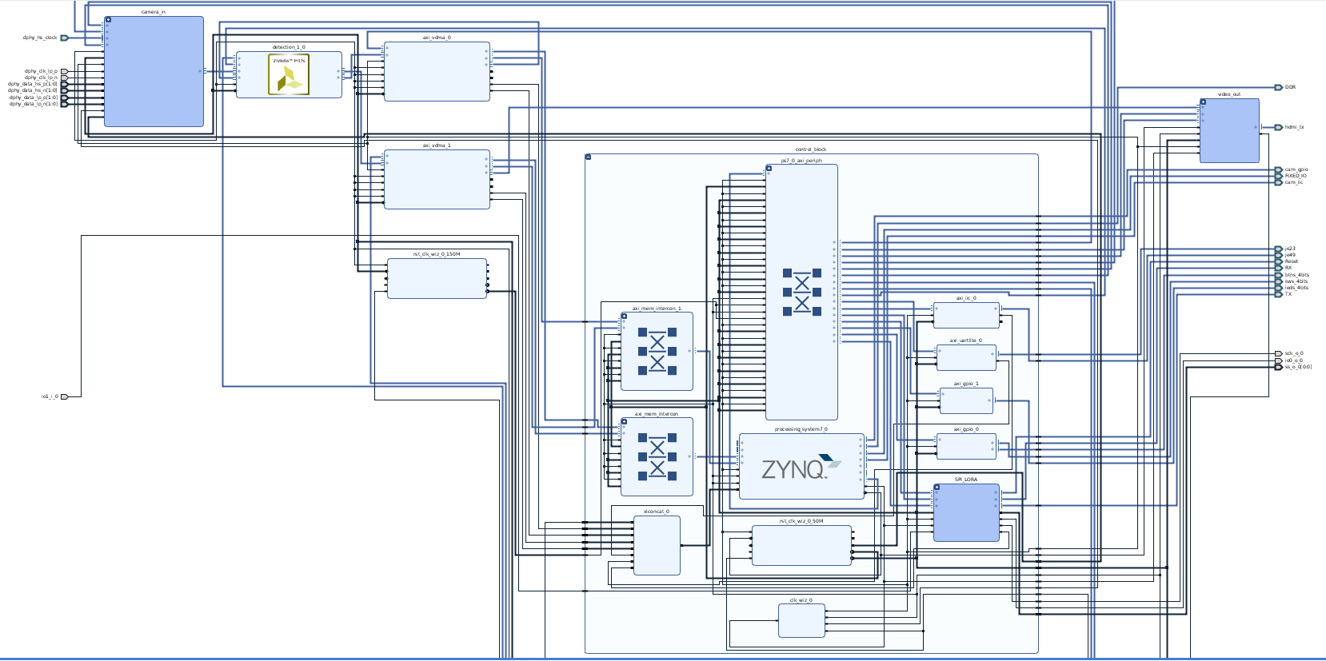
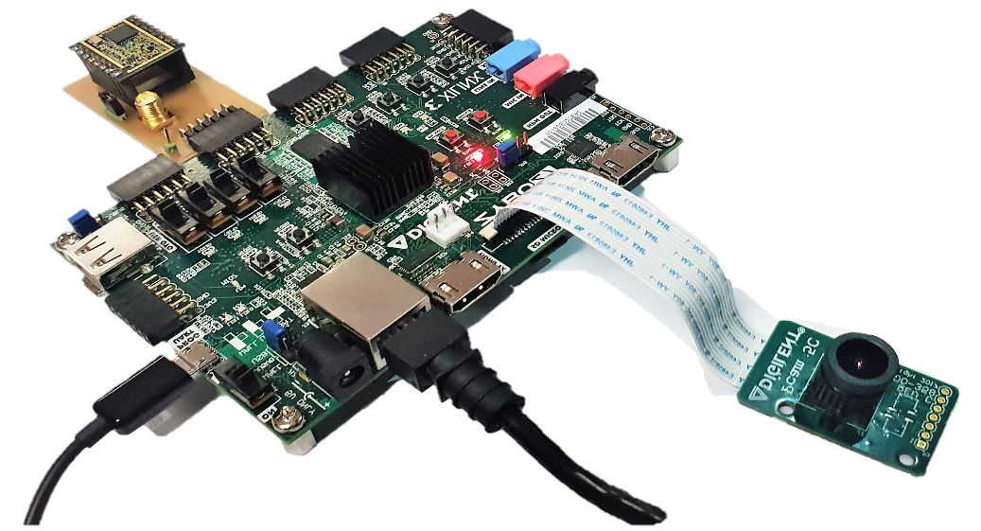
SmART GATEWAY : DESIGN
Hardware Desgin Smart Camera

Slide 18
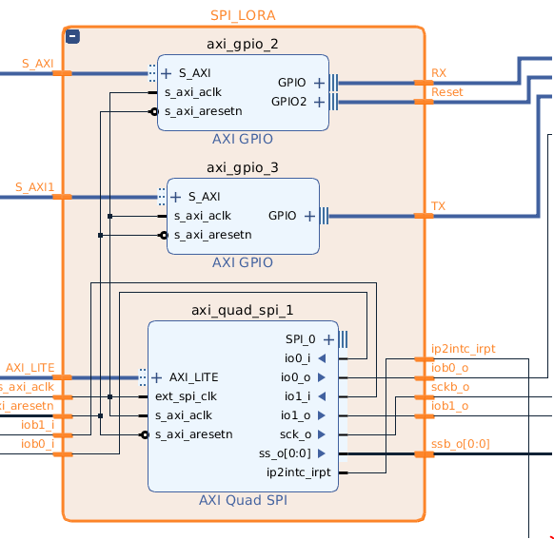
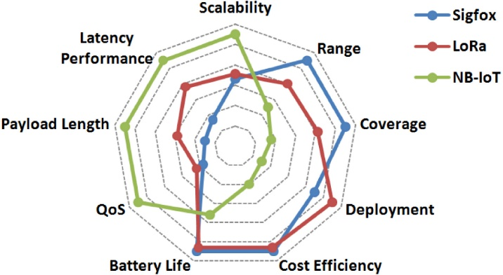
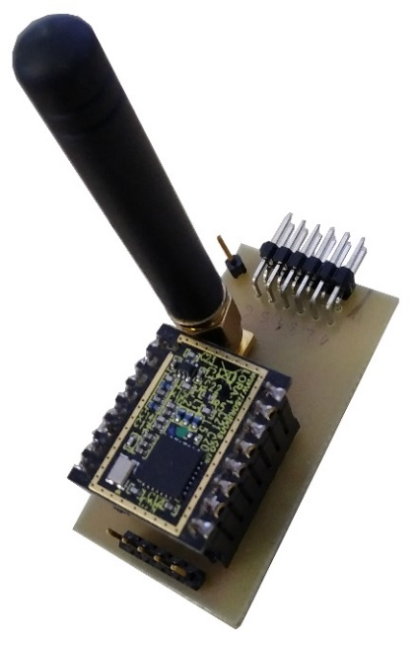

SmART GATEWAY : LORA DEVICE
IP Design for LoRa Transceiver
IP Block Design of PMOD LORA for ZYBO Z7
Pmod LoRa par Paul LELOUP.2019
Respective advantages of Sigfox, LoRa, and NB-IoT in terms of IoT factors. [1]
Notes:
After processing images, the ZYBO choose to send the information through LoRa to other devices or to IP Network
Sending short messages with LoRa Transceiver
Receiving information from Smart Sensors

Slide 19
DISCUSSIONs
Problems encountered :
Some Fail in electronics cards
Using Both Cortex A9 Cores of the ZYNQ with an AMP mode
Configuration of the Semtech RF-LoRa-868-SO
Enrigeenring Resources used :
Electronic card machine
Computer
Camera, Transceiver modules and Data Image Processing algorithmes

Slide 20
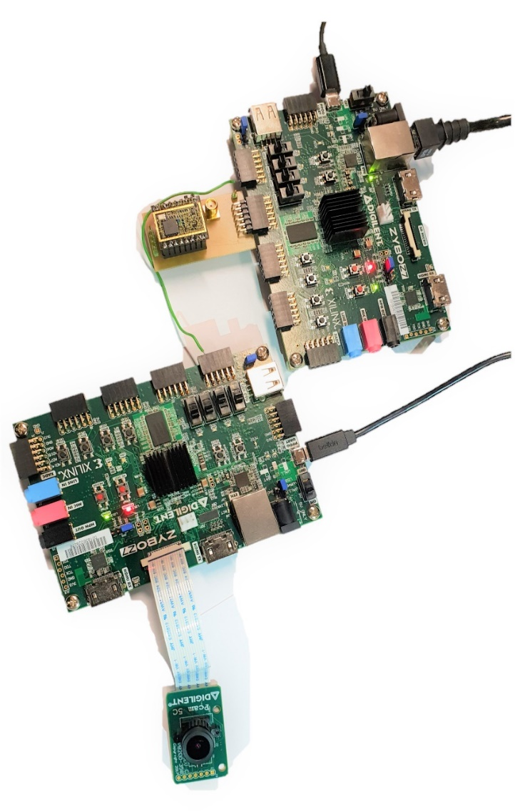
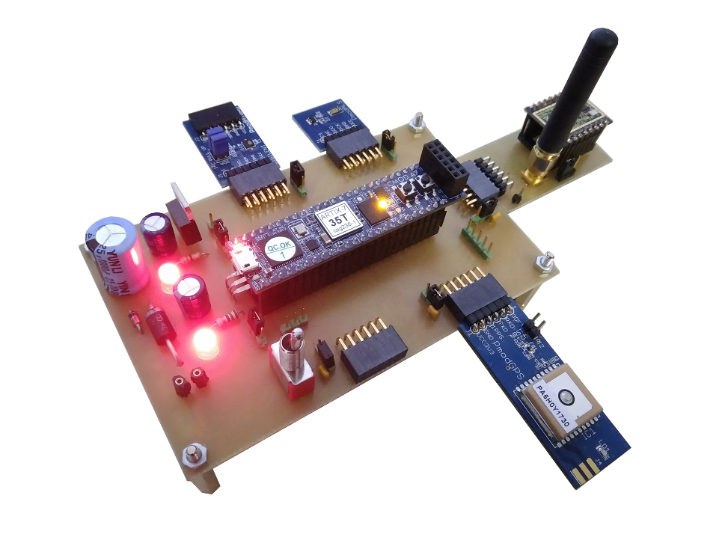
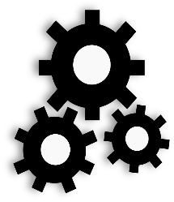

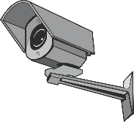
DiSCUSSION / CONCLUSION

Slide 21
DEMONSTRATION

Slide 22
Bibliography
[1] A comparative study of LPWAN technologies for large-scale IoT deployment
Kais Mekki, Eddy Bajic, Frederic Chaxel, Fernand Meyer. Research Centre for Automatic Control of Nancy, Campus Sciences.

